Slide 1
Predicting Injury Risk in the NBA A Machine Learning Approach
Peter Sarkis, Thejus Kannoth, Matthew Smolzer, Mounika Munigala
Group 7
March 19, 2025
DSC 672 & 394

Slide 2
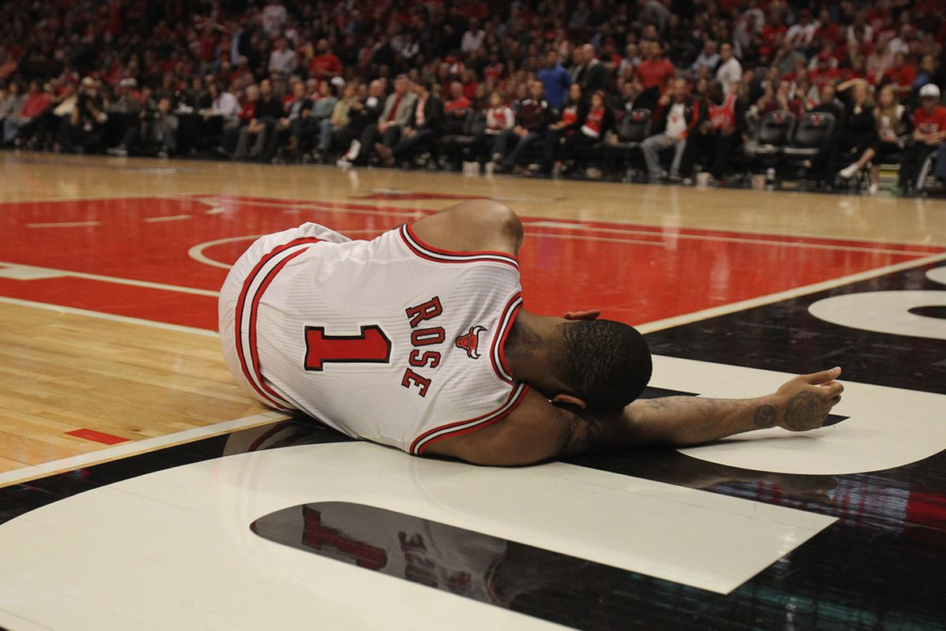
Introduction
NOTE:
To change images on this slide, select a picture and delete it. Then click the Insert Picture icon
in the placeholder to insert your own image.
Injuries impact NBA team performance, player careers, and financial investments.
Predicting injury risk helps teams manage players effectively.
Machine learning (ML) offers a data-driven approach to predicting injury risk.
Goal: Build a machine learning model to forecast NBA player injuries using historical data.

Slide 3
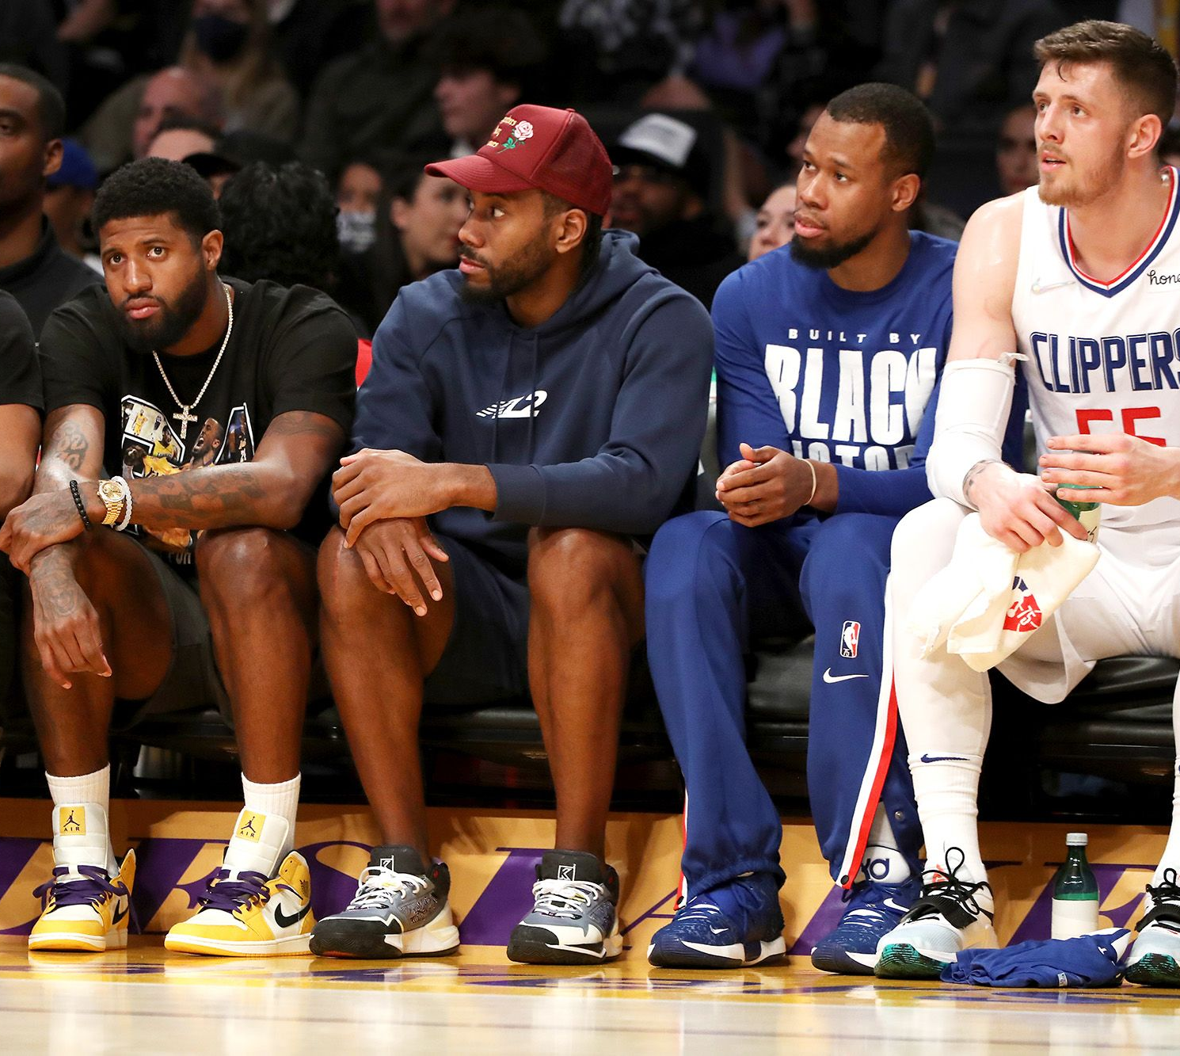
How is your solution valuable? (Value Proposition)
Accurately predicting injuries in NBA players can…
Help teams and medical staff take proactive measures to reduce injury risks.
Optimize player workload and reduce injuries.
Extend player careers and enhance team performance.
Reduce financial losses due to injuries.
Provide teams with a competitive edge in player health management.

Slide 4
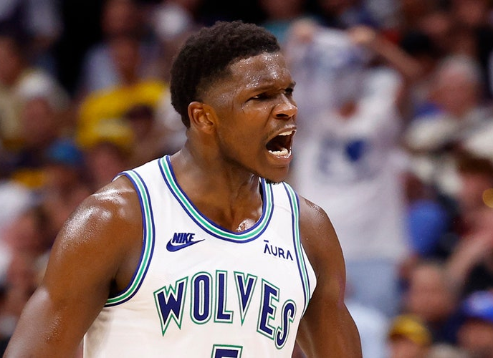
Literature Review
NOTE:
To change images on this slide, select a picture and delete it. Then click the Insert Picture icon
in the placeholder to insert your own image.
A summary from 20+ references:
ML has been applied in sports injury prediction with promising results.
Key predictors include workload, injury history, and biomechanics.
Various ML models such as XGBoost, Decision Trees and Random Forest have been used in sports analytics.

Slide 5
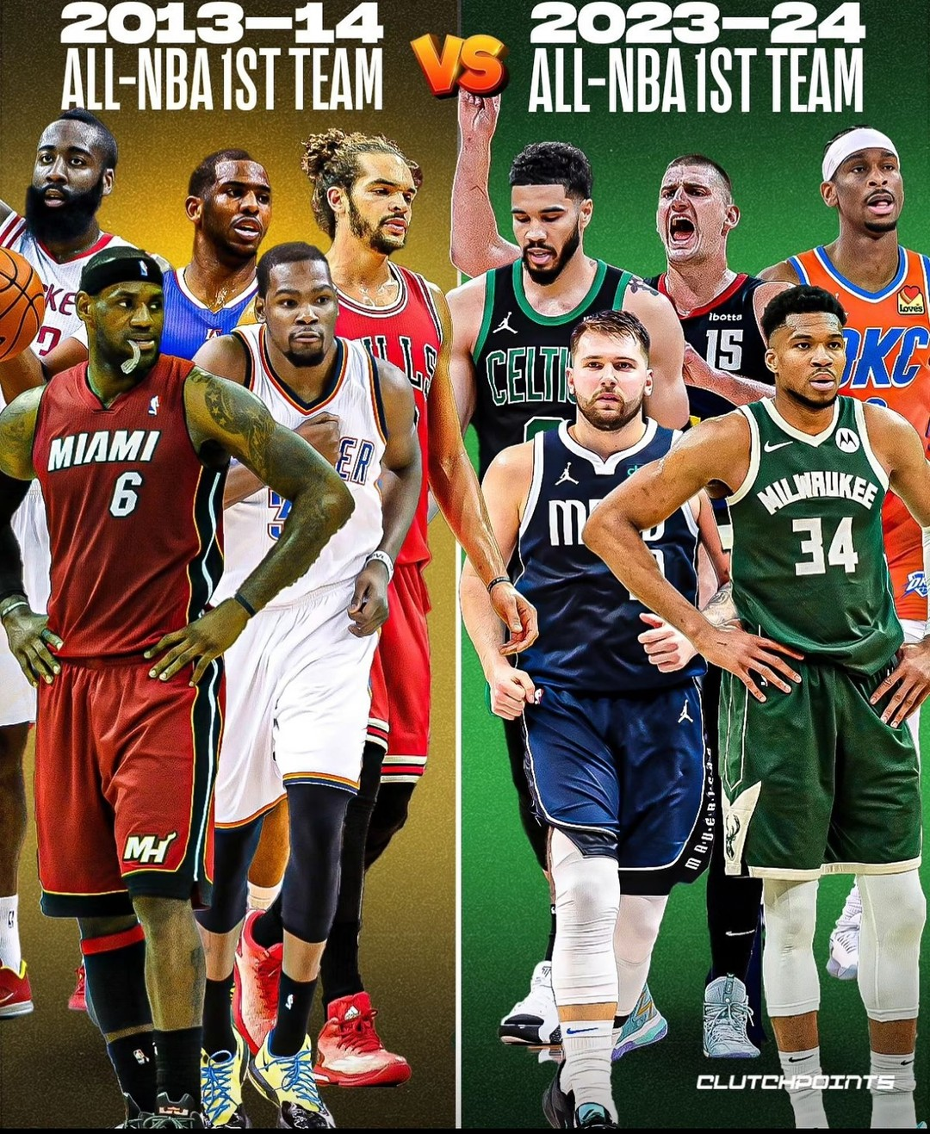
Data and Metrics
https://www.kaggle.com/datasets/icliu30/nba-player-stats-and-injured-data-from-13-to-23
Dataset: Kaggle – NBA Player Stats and Injured Data (2013-2023)
1200+ rows, 32 columns
Key Features:
Workload metrics: Games played, minutes played
Player attributes: Age, weight, height
Performance stats: usage percentage, pace, speed
Injury data: Injury type, days missed, return date
The dependent variable is Injured Type, which categorizes the type of injury sustained by the player.

Slide 6
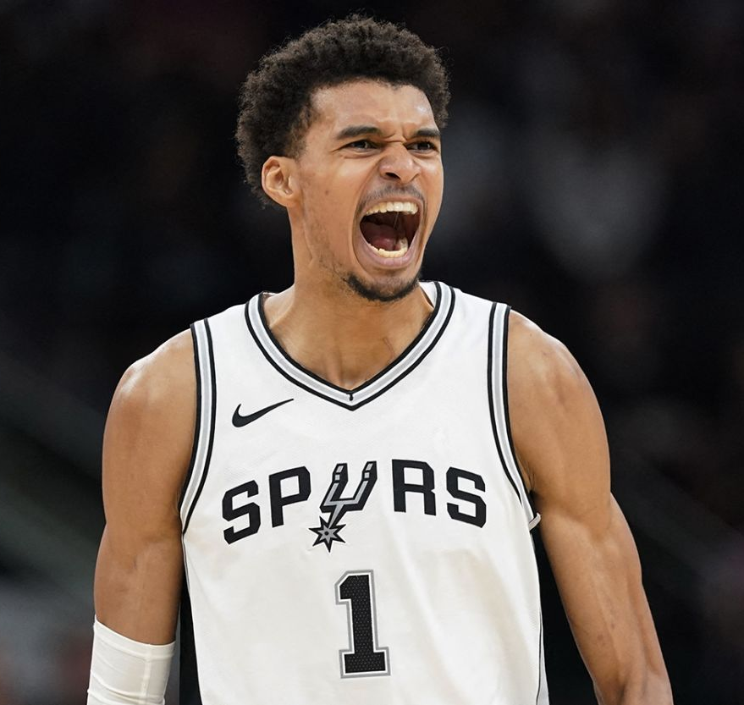
Data Preprocessing & Feature Selection
NOTE:
To change images on this slide, select a picture and delete it. Then click the Insert Picture icon
in the placeholder to insert your own image.
Addressed missing values and removed duplicates.
Categorical variables converted for ML compatibility.
Standardized numerical features.
Feature importance analysis conducted.

Slide 7
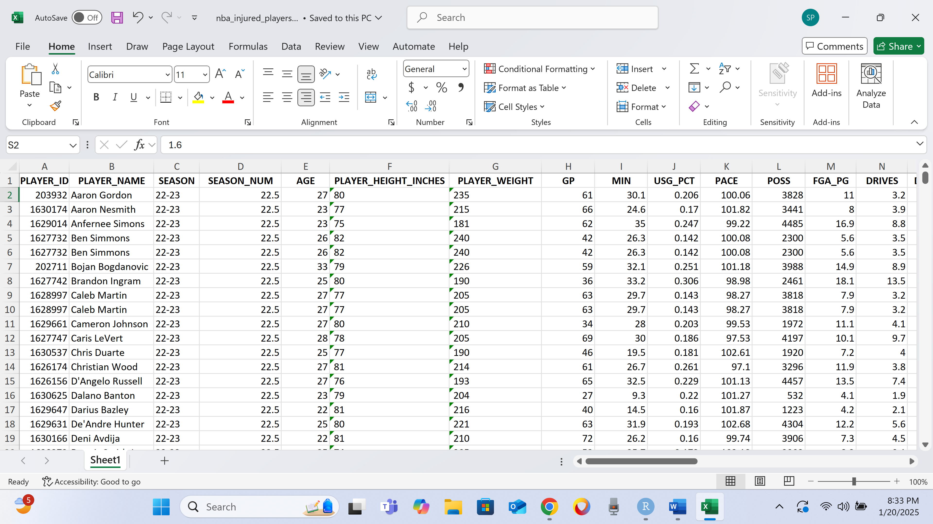
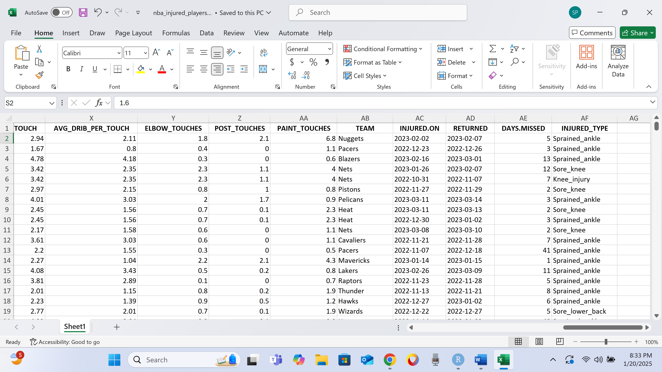
Snapshot of dataset
Notes:
A statistical summary and visual snapshot of the dataset can be seen below to give insight into key trends and distributions before model implementation.

Slide 8

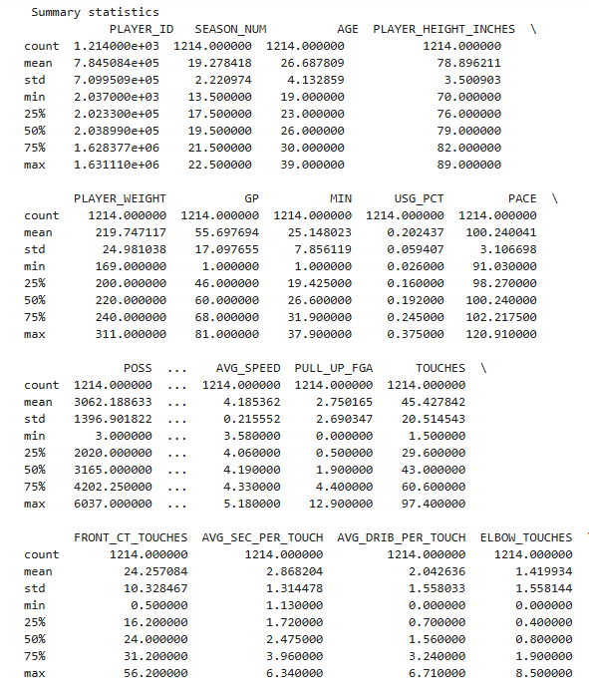
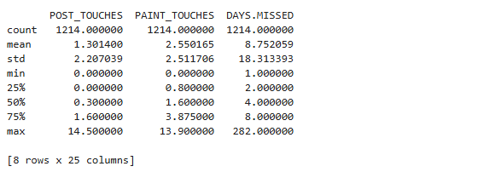
Statistical Summaries

Slide 9
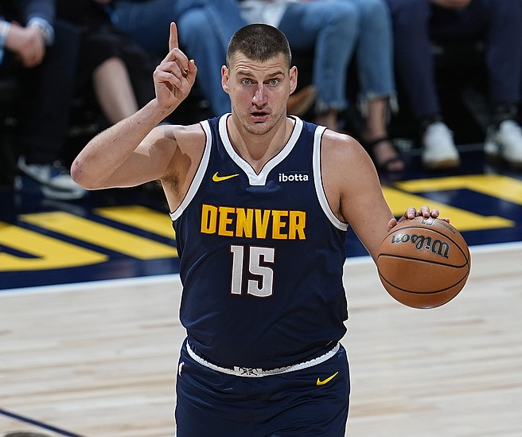
Methods: Research Questions
NOTE:
To change images on this slide, select a picture and delete it. Then click the Insert Picture icon
in the placeholder to insert your own image.
What are the key factors that contribute to NBA player injuries?
Can ML models accurately predict injury risk using player statistics?
How does a player’s workload influence their injury risk?
Do injury risks vary based on a player’s position or age group?

Slide 10
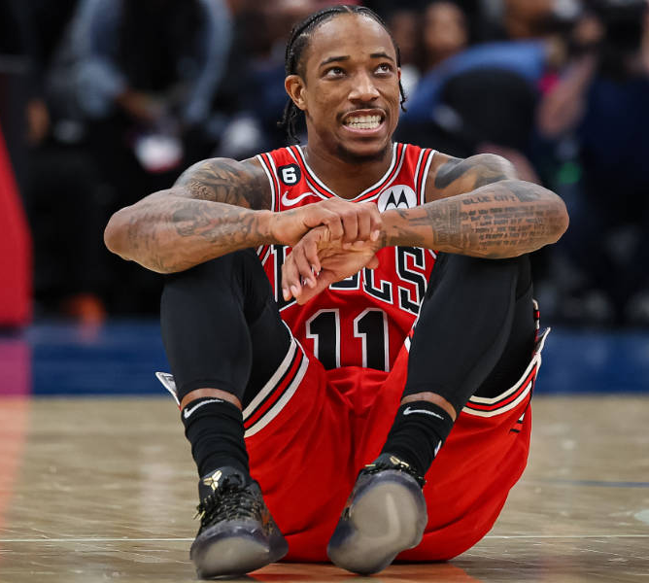
Exploratory Data Analysis (EDA)
NOTE:
To change images on this slide, select a picture and delete it. Then click the Insert Picture icon
in the placeholder to insert your own image.
Histogram: Age distribution of injured players.
Bar charts: Most common injury types, average recovery time.
Scatter matrix: Correlation between injury risk and key workload metrics.
Notes:
To gain a deeper understanding of the NBA dataset, we conducted an exploratory data analysis (EDA) that includes statistical summaries, visualizations, and correlation analysis. Besides statistical summaries, various visualizations were created to examine injury trends and relationships between workload metrics and injuries.

Slide 11
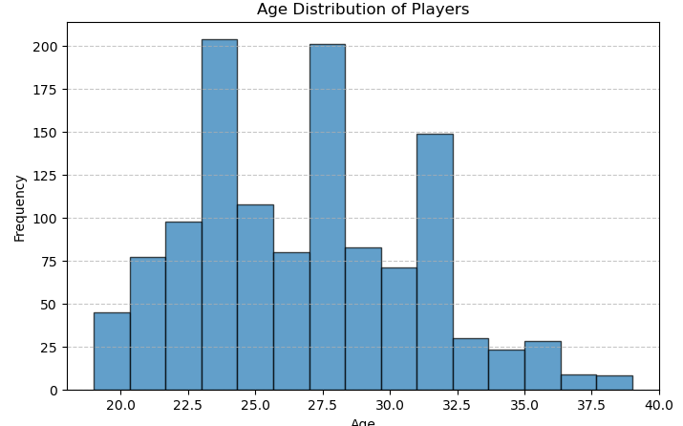
Data Visualizations
Figure 1. Histogram to identify the most common age range among players and potential trends related to injury risk in the NBA.

Slide 12
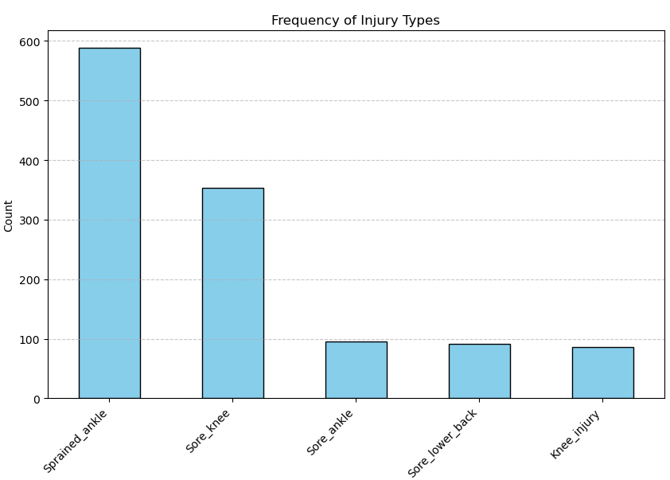
Data Visualizations
Figure 2. Bar chart to identify injury patterns and potential risk factors, highlighting which injuries are most common among NBA players.

Slide 13
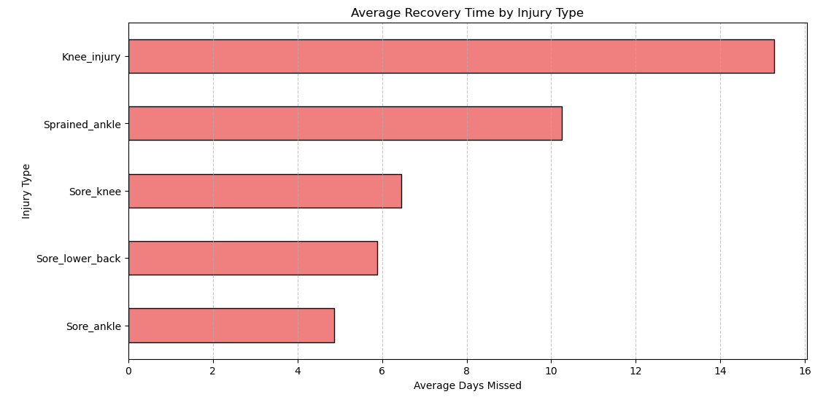
Data Visualizations
Figure 3. Bar chart illustrates the average recovery time by injury type, measured in average days missed. This shows which injuries typically require the longest recovery periods, helping to assess their impact on player availability.

Slide 14
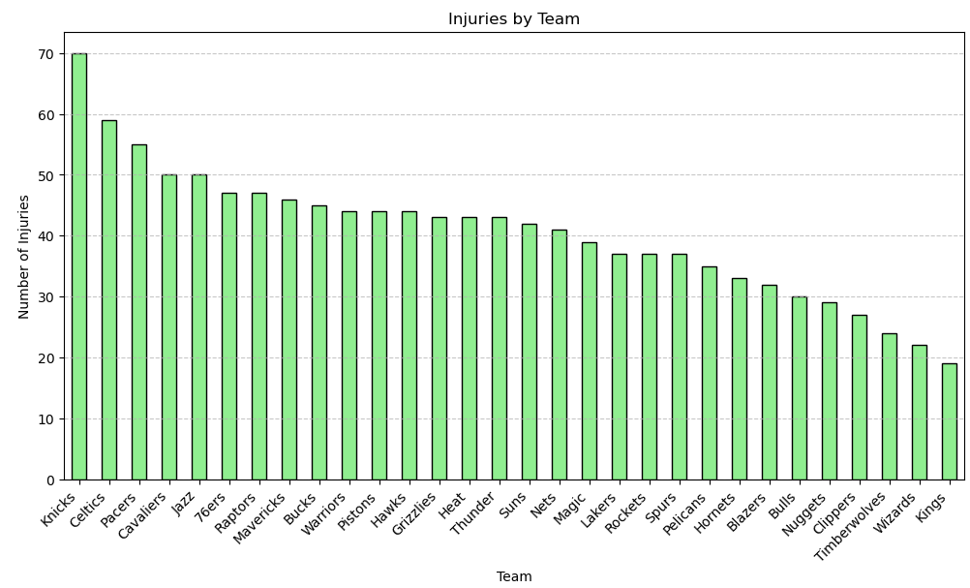
Data Visualizations
Figure 4. Bar chart shows the average number of injuries per team, highlighting which teams experience more injuries on average.

Slide 15
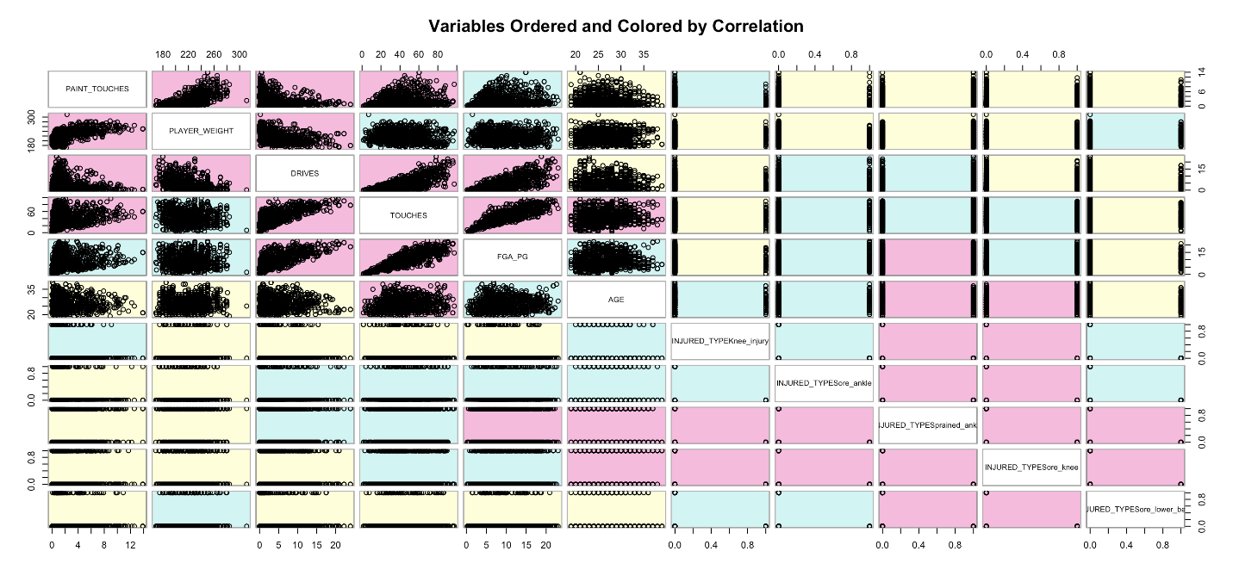
Data Visualizations
Figure 5. This scatter matrix shows the correlation between our response variable (injury type) and our most significant predictors. The matrix is color coded to best show the strength of correlations with red being more correlated, and green being least correlated.

Slide 16
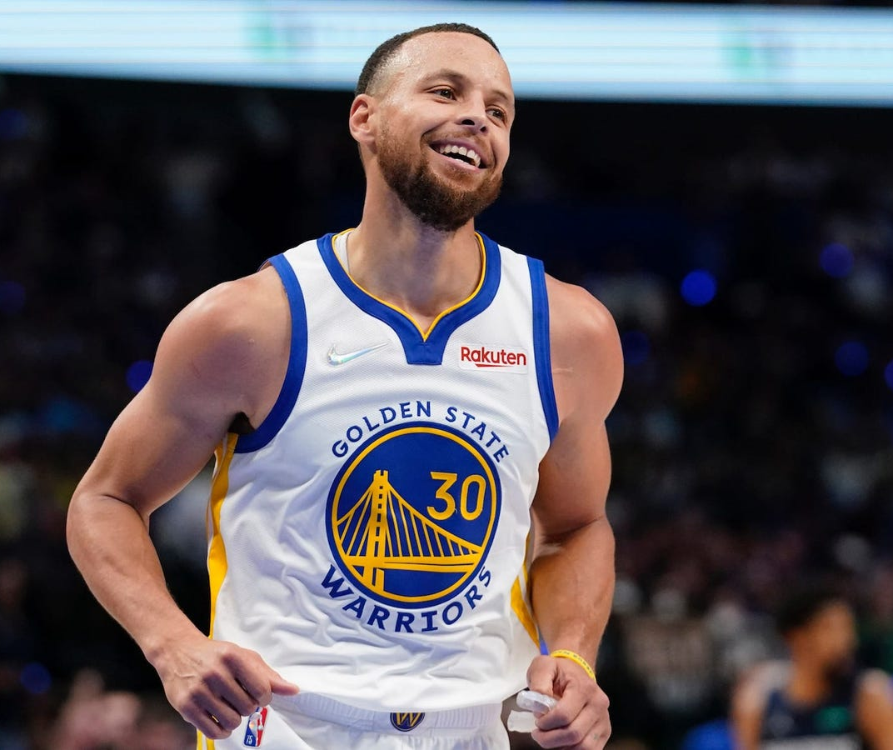
Methods: Machine Learning
NOTE:
To change images on this slide, select a picture and delete it. Then click the Insert Picture icon
in the placeholder to insert your own image.
Models:
Logistic Regression
Decision Trees
K-Nearest Neighbors (KNN)Random Forest
Gradient Boosting (XGBoost)
Principal Component Analysis (PCA)
Suport Vector Machine (SVM)
Other Techniques:
Feature Selection
Cross-validation
SMOTE
Standard Scaling
Label Encoding
Hyperparameter Tuning

Slide 17
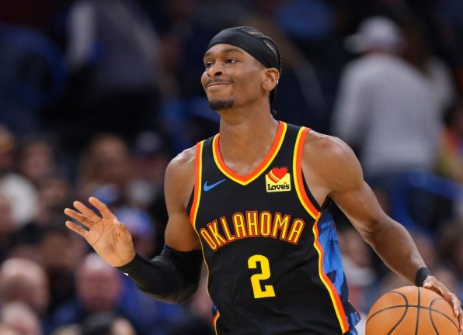
Model Training & Evaluation
NOTE:
To change images on this slide, select a picture and delete it. Then click the Insert Picture icon
in the placeholder to insert your own image.
Training/Test Split: 80% training, 20% testing.
Cross-validation: Prevents overfitting.
Metrics Used: Accuracy, Precision, Recall, F1-score
Notes:
Accuracy (Measures overall correctness)
Precision & Recall (False Positives vs. False Negatives)
F1-Score (Balances Precision & Recall)
AUC-ROC (Performance across classification thresholds)

Slide 18
Results
NOTE:
To change images on this slide, select a picture and delete it. Then click the Insert Picture icon
in the placeholder to insert your own image.
Machine Learning Algorithm | Pre-processing Techniques | Accuracy | Precision | F1-Score | Recall
Logistic | SMOTE | 0.4689 | 0.395 | 0.47 | 0.47
Linear | PCA | 0.369 | 0.399 | 0.37 | 0.37
XGBoost | SMOTE | 0.6183 | 0.4112 | 0.62 | 0.62
XGBoost | SMOTE w/ Cross Validation | 0.9797 | 0.959 | 0.97 | 0.97
K-Nearest Neighbors (KNN) | Standard Scaling | 52.1 | 0.54 | 0.48 | 0.52
Random Forest (Optimized) | Standard Scaling, Hyperparameter Tuning | 57 | 0.55 | 0.57 | 0.53
Random Forest (Optimized) | Standard Scaling, Hyperparameter Tuning, SMOTE | 53 | 0.51 | 0.52 | 0.53
Support Vector Machine (SVM) | Standard Scaling, SMOTE | 44.44 | 0.49 | 0.46 | 0.44
Decision Tree | Standard Scaling, | 45 | 0.45 | 0.45 | 0.45

Slide 19
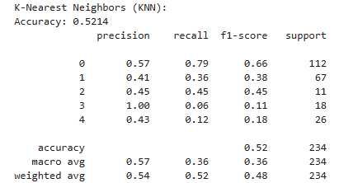
Results – K-Nearest Neighbors (KNN)
NOTE:
To change images on this slide, select a picture and delete it. Then click the Insert Picture icon
in the placeholder to insert your own image.
KNN was trained using standard scaling to normalize the data, ensuring fair distance calculations between points.
The model achieved an accuracy of 52.1%.
While KNN performed better than some models, its reliance on distance metrics may have impacted results due to high-dimensional feature space.

Slide 20
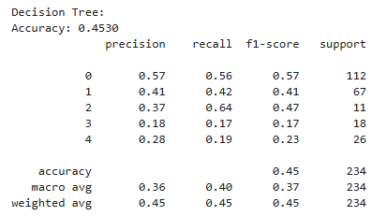
Results – Decision Tree
NOTE:
To change images on this slide, select a picture and delete it. Then click the Insert Picture icon
in the placeholder to insert your own image.
The Decision Tree model was trained with standard scaling but without additional optimization techniques.
The accuracy was 45%, with relatively balanced precision and recall, showing moderate predictive power.
Although simple and interpretable, Decision Tree models are prone to overfitting, which likely contributed to its lower performance compared to Random Forest.

Slide 21
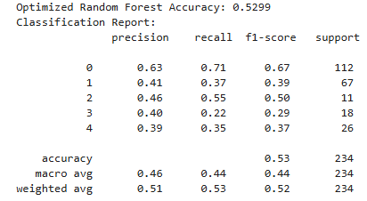
Results – Random Forest (Optimized with SMOTE)
NOTE:
To change images on this slide, select a picture and delete it. Then click the Insert Picture icon
in the placeholder to insert your own image.
This version of Random Forest incorporated SMOTE to address class imbalance in the dataset.
Despite handling imbalance, the model's accuracy slightly dropped to 53%, possibly due to the synthetic nature of new samples.
Precision and recall remained stable, showing that SMOTE helped balance the predictions across different injury types.

Slide 22
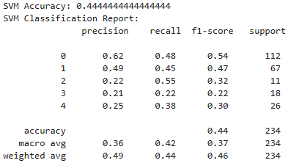
Results – Support Vector Machine (SVM)
NOTE:
To change images on this slide, select a picture and delete it. Then click the Insert Picture icon
in the placeholder to insert your own image.
SVM was trained using standard scaling and SMOTE to handle class imbalance and optimize decision boundaries.
The model performed lower than Random Forest, with an accuracy of 44.44%, indicating that linear separability may not be effective for this dataset.
The precision and recall metrics suggest that while SVM captured some patterns, it struggled with complex injury prediction scenarios.

Slide 23
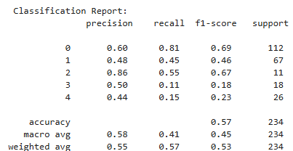
Results – Random Forest (Optimized)
NOTE:
To change images on this slide, select a picture and delete it. Then click the Insert Picture icon
in the placeholder to insert your own image.
Random Forest was optimized using standard scaling and hyperparameter tuning to enhance model performance.
The accuracy reached 57%, with improved precision and recall scores, making it the best-performing model.
The ensemble approach helped mitigate overfitting and improved generalization, making it a robust choice for injury prediction.

Slide 24
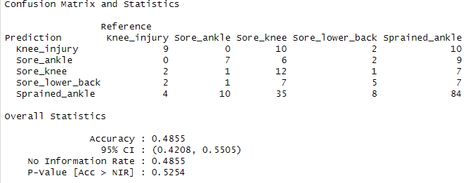
Results – Logistic Regression
NOTE:
To change images on this slide, select a picture and delete it. Then click the Insert Picture icon
in the placeholder to insert your own image.
The first model attempted was a logistic regression due to the non-linearity of the data.
This model was 48.55% accurate with a low precision as well.
The model was most effective at predicting ankle injuries, but struggled greatly with knee injuries.

Slide 25
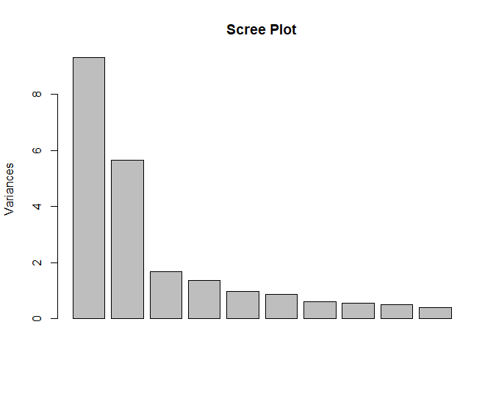
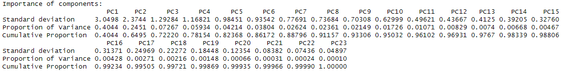
Results – PCA with Linear Regression
NOTE:
To change images on this slide, select a picture and delete it. Then click the Insert Picture icon
in the placeholder to insert your own image.
A PCA was then attempted to reduce the number of predictors and make a more accurate model
The first 6 components were used, while it seems that only the first 4 were needed, accuracy did increase with 5 and 6 added.

Slide 26
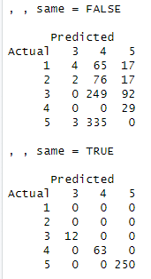
Results – PCA with Linear Regression Cont.
NOTE:
To change images on this slide, select a picture and delete it. Then click the Insert Picture icon
in the placeholder to insert your own image.
This model was not very accurate as was unable to predict knee injuries or sore ankles.
Thus, the model was only 36.9% accurate with a low precision as well.
The top table is the number of incorrect and the bottom is the number of correct predictions. As shown, the model was quick to label most injuries as lower back injury, but did find the most success in the sprained ankle predictions.

Slide 27
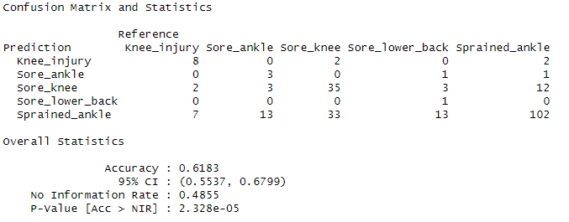
Results – XGBoost
NOTE:
To change images on this slide, select a picture and delete it. Then click the Insert Picture icon
in the placeholder to insert your own image.
This model was more accurate and precise and was able to predict all types of injuries better than previous models.
Sore knees were the most commonly mistaken injury, but the number of errors was still low.
Because of the large amounts of sprained ankles relative to other injury types, it is the most commonly mistaken injury in this model.

Slide 28
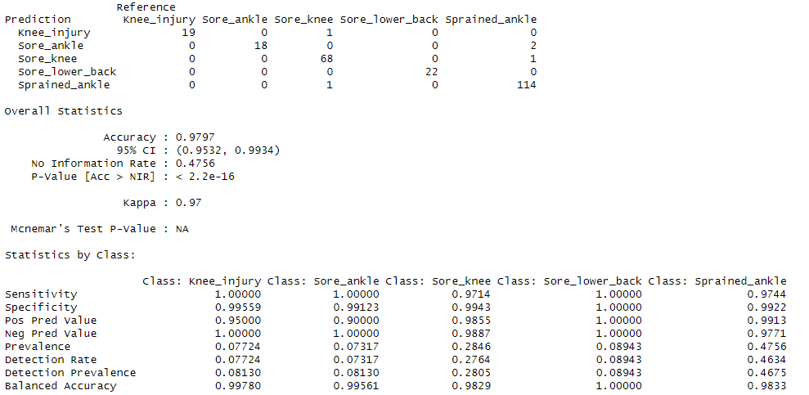
Results – XGBoost with Cross-Validation
NOTE:
To change images on this slide, select a picture and delete it. Then click the Insert Picture icon
in the placeholder to insert your own image.
This model was the most accurate and precise model found.
Sore knees were the most commonly mistaken injury, but the number of errors was still low.
By adding in cross-validation, the model splits the train data into its own train and test set, allowing for each round to become more accurate. This allows for the accuracy and precision to rise as less incorrect predictions are made by the model.

Slide 29
Visualizations (Edit this Thejus and Matt)
NOTE:
To change images on this slide, select a picture and delete it. Then click the Insert Picture icon
in the placeholder to insert your own image.
Create some visualizations that answer our 4 research questions:
What are the key factors that contribute to NBA player injuries?
Can ML models accurately predict injury risk using player statistics?
How does a player’s workload influence their injury risk?
Do injury risks vary based on a player’s position or age group?

Slide 30
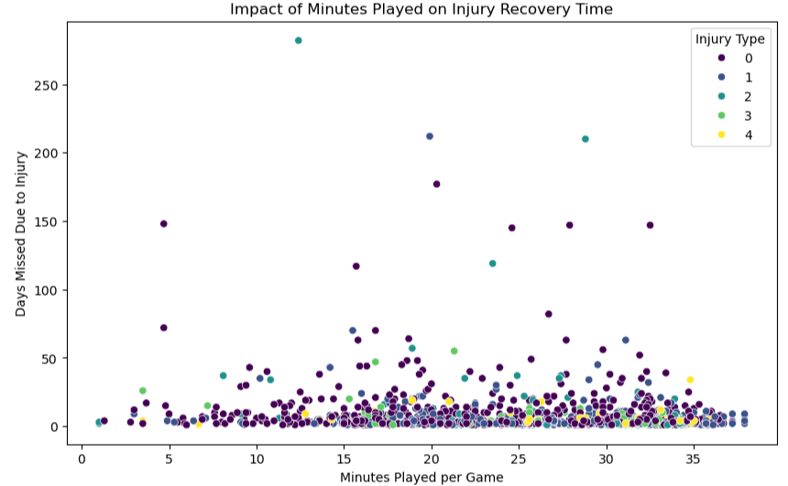
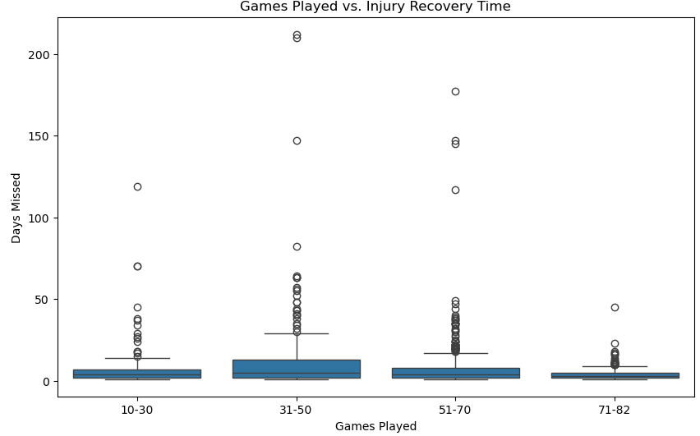
Visualizations: Workload and Injury Risk
NOTE:
To change images on this slide, select a picture and delete it. Then click the Insert Picture icon
in the placeholder to insert your own image.
The scatter plot shows the relationship between minutes played per game and the number of days missed due to injury. While most players with higher minutes played per game miss only a few days, some outliers experience significantly longer recovery periods. This suggests that workload alone is not the primary factor influencing injury severity, and other factors such as injury type and player conditioning also play a role.
The box plot categorizes players based on the number of games played in a season and the corresponding days missed due to injury. Players who participated in fewer games (10-50) tend to have higher variance in days missed, with extreme outliers indicating long recovery periods. This implies that players with fewer games played may have suffered more severe injuries, leading to prolonged recovery, whereas those who played a full season (71-82 games) tended to miss fewer days.

Slide 31
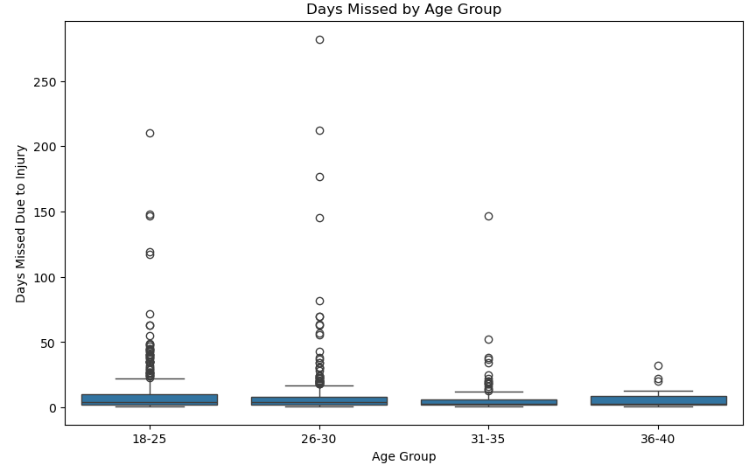
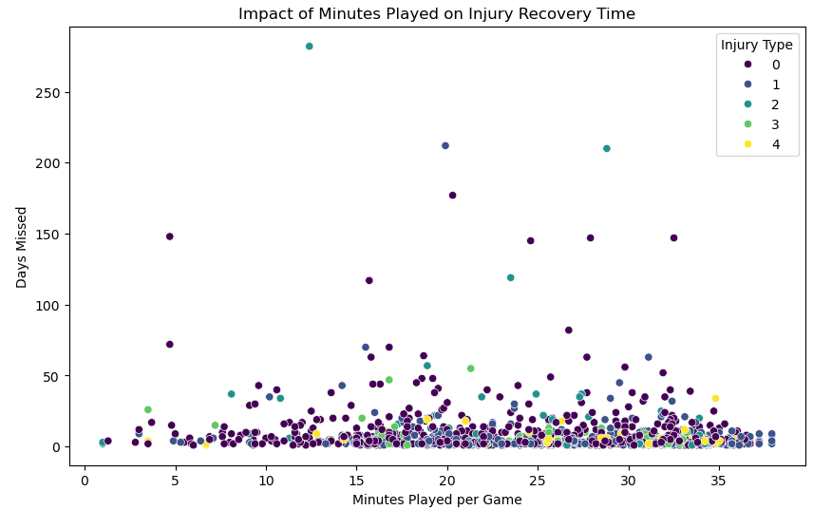
Visualizations: Injury Risk by Age Group and Workload
NOTE:
To change images on this slide, select a picture and delete it. Then click the Insert Picture icon
in the placeholder to insert your own image.
The first box plot analyzes injury risk across different age groups. While median recovery times remain consistent, younger players (18-30) exhibit more extreme outliers, suggesting that some severe injuries disproportionately affect younger athletes. This could be due to high-intensity play styles and increased workload at a younger age.
The scatter plot explores the impact of minutes played on injury recovery time. While most players miss only a few days regardless of playing time, some outliers with moderate playing time (10-25 minutes) experience significantly extended recovery periods. This suggests that injury severity and individual conditioning may play a larger role than total minutes played.

Slide 32
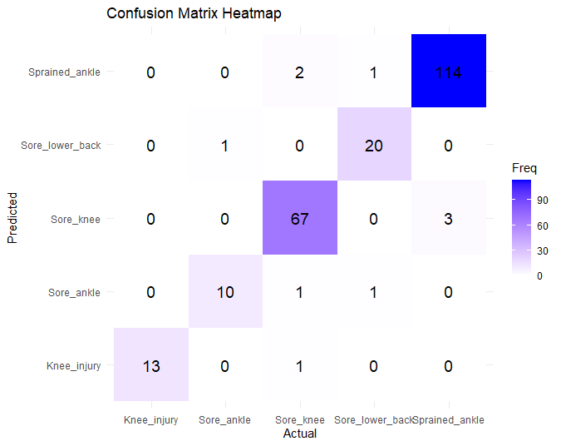
Visualizations: XGBoost Accuracy Visualized
NOTE:
To change images on this slide, select a picture and delete it. Then click the Insert Picture icon
in the placeholder to insert your own image.
This heatmap shows the confusion matrix used to see the accuracy of the XGB model. The shaded values along the diagonal are the values that were predicted to be correct. The other numbers off of the diagonal indicate false positives or incorrect values. As shown by the heatmap, the model is highly accurate in its predictions.

Slide 33
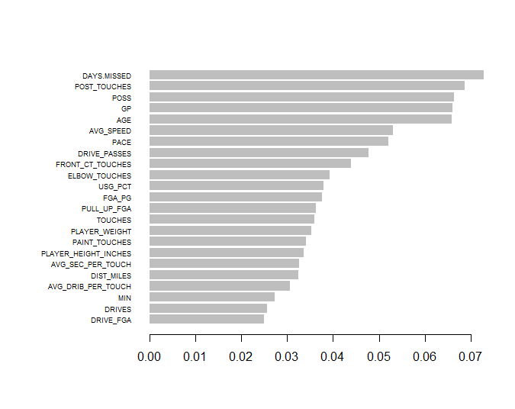
Visualizations: Ranking of Importance
NOTE:
To change images on this slide, select a picture and delete it. Then click the Insert Picture icon
in the placeholder to insert your own image.
These were the effectiveness of all the variables on predicting the 5 types of injuries. As we can see, besides days missed, the number of post touches, possessions, games played, and age were the biggest contributors to injury.

Slide 34
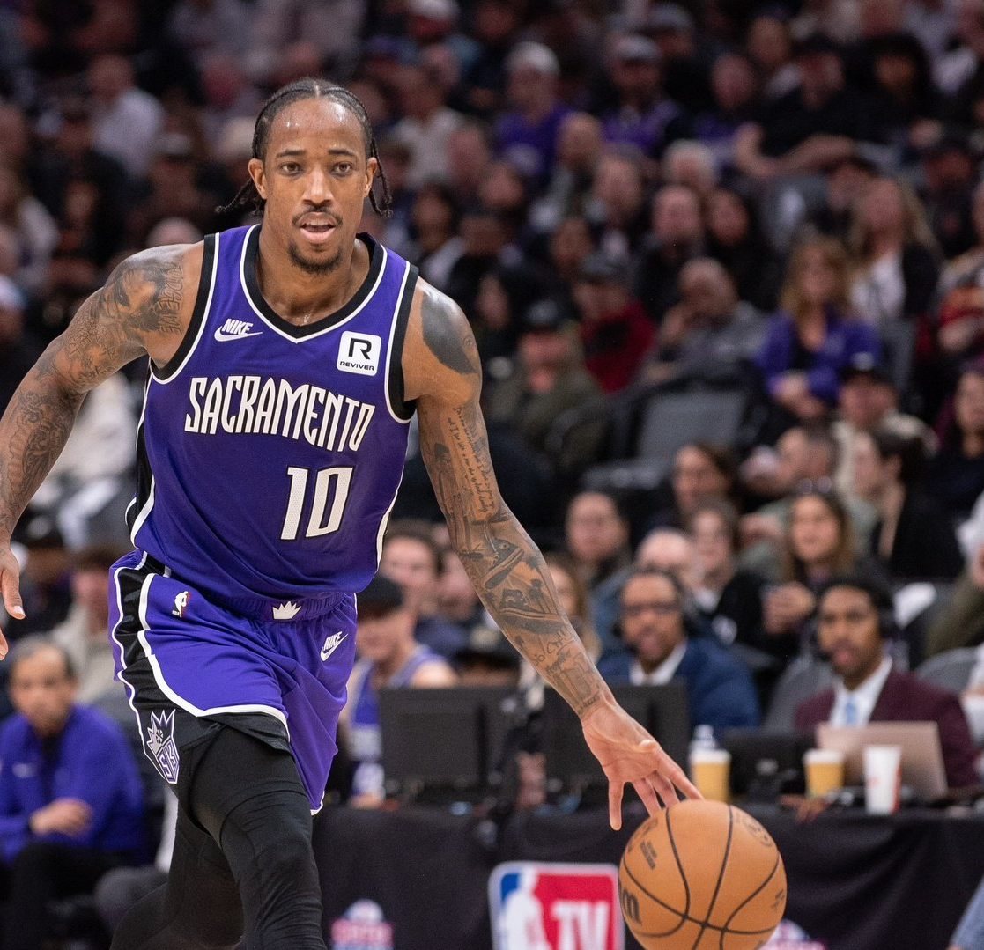
Discussion
NOTE:
To change images on this slide, select a picture and delete it. Then click the Insert Picture icon
in the placeholder to insert your own image.
Workload and prior injuries are strong predictors of future injuries.
ML models improve injury risk assessment and player management.
Teams can use data-driven strategies to prevent injuries and extend player careers.

Slide 35
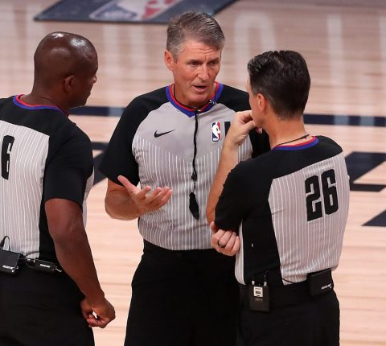
Future Work
NOTE:
To change images on this slide, select a picture and delete it. Then click the Insert Picture icon
in the placeholder to insert your own image.
Expand dataset to multiple sports to generalize findings.
Use reinforcement learning to optimize player workload and rest based on real-time injury risk.
Validate ML predictions with sports scientists and medical professionals for practical applications.

Slide 36
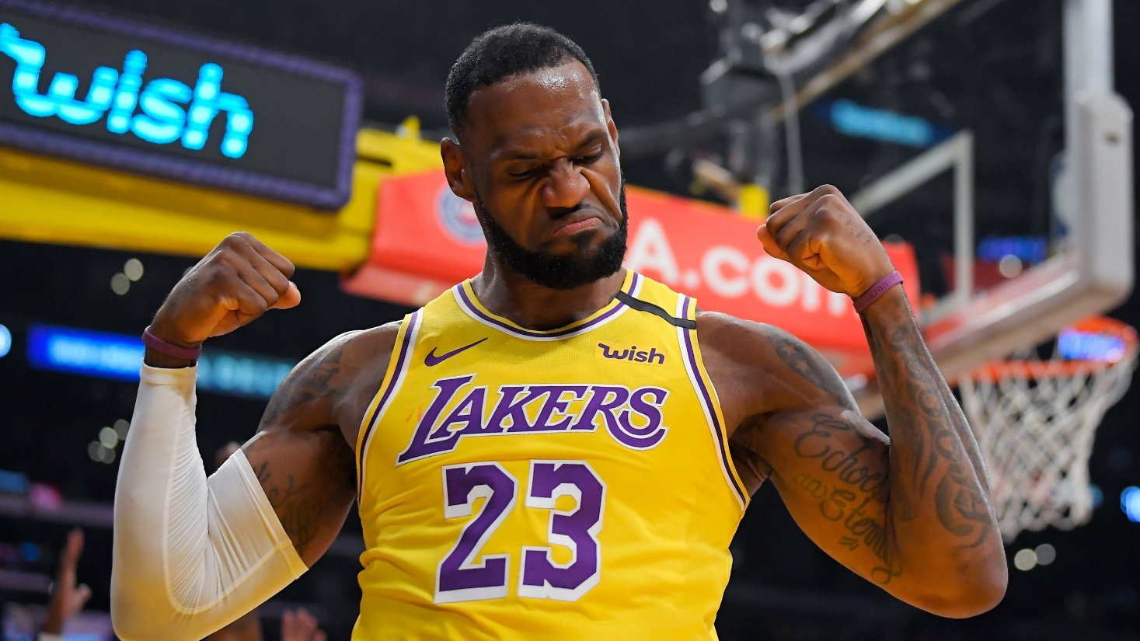
Conclusion
NOTE:
To change images on this slide, select a picture and delete it. Then click the Insert Picture icon
in the placeholder to insert your own image.
ML models, especially ensemble methods leverage predictions for injury prevention.
Findings can enhance decision-making for teams, trainers, and medical staff.
Bridging analytics and sports medicine can improve player health and team performance.

Slide 37
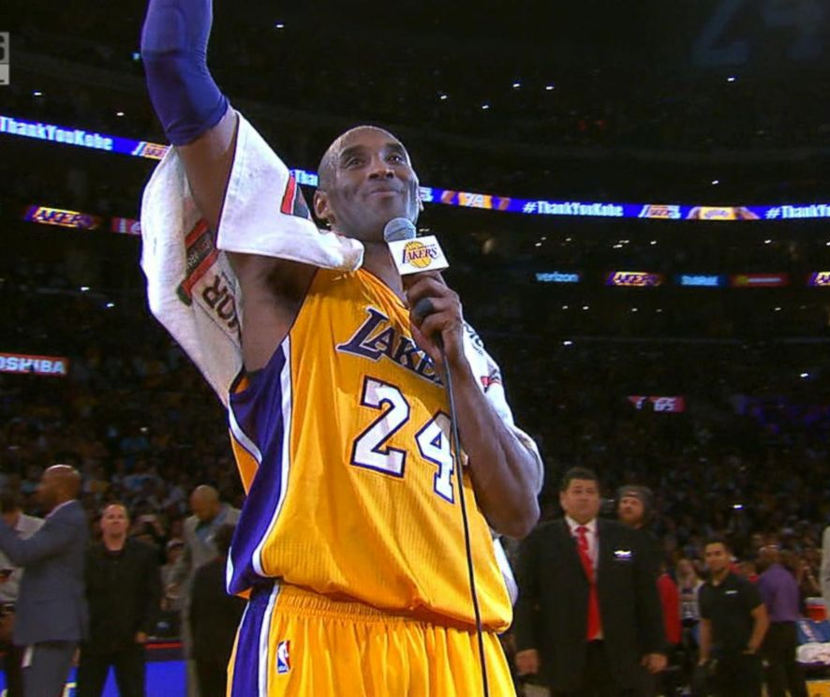
Thank you!

